Slide 1
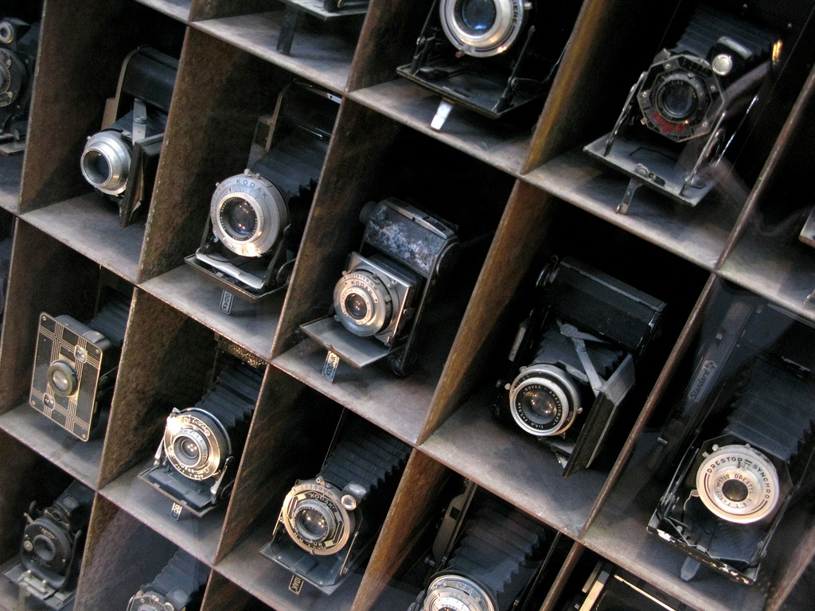
Cameras
Slide deck courtesy Svetlana Lazebnik

Slide 2
Overview
The pinhole projection model
Qualitative properties
Perspective projection matrix
Cameras with lenses
Depth of focus
Field of view
Lens aberrations
Digital cameras
Sensors
Color
Artifacts

Slide 3
Let’s design a camera
Idea 1: put a piece of film in front of an object
Do we get a reasonable image?
Slide by Steve Seitz

Slide 4
Pinhole camera
Add a barrier to block off most of the rays
This reduces blurring
The opening is known as the aperture
Slide by Steve Seitz
Notes:
It gets inverted

Slide 5
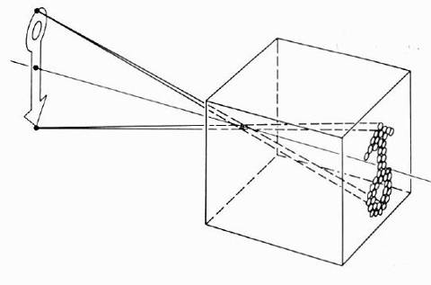
Pinhole camera model
Pinhole model:
Captures pencil of rays – all rays through a single point
The point is called Center of Projection (focal point)
The image is formed on the Image Plane
Slide by Steve Seitz

Slide 6
Dimensionality reduction: from 3D to 2D
3D world
2D image
What is preserved?
Straight lines, incidence
What have we lost?
Angles, lengths
Slide by A. Efros
Figures © Stephen E. Palmer, 2002

Slide 7
Projection properties
Many-to-one: any points along same visual ray map to same point in image
Points → points
But projection of points on focal plane is undefined
Lines → lines (collinearity is preserved)
But lines through focal point (visual rays) project to a point
Planes → planes (or half-planes)
But planes through focal point project to lines

Slide 8
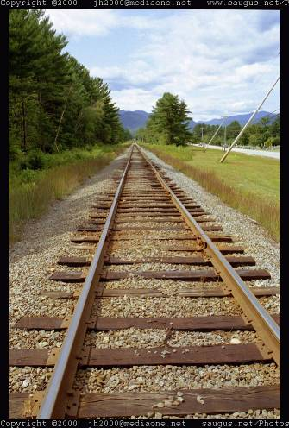
Vanishing points
Each direction in space has its own vanishing point
All lines going in that direction converge at that point
Exception: directions parallel to the image plane

Slide 9
Vanishing points
Each direction in space has its own vanishing point
All lines going in that direction converge at that point
Exception: directions parallel to the image plane
How do we construct the vanishing point of a line?
What about the vanishing line of a plane?
image plane
vanishing point
camera
center
line on ground plane

Slide 10
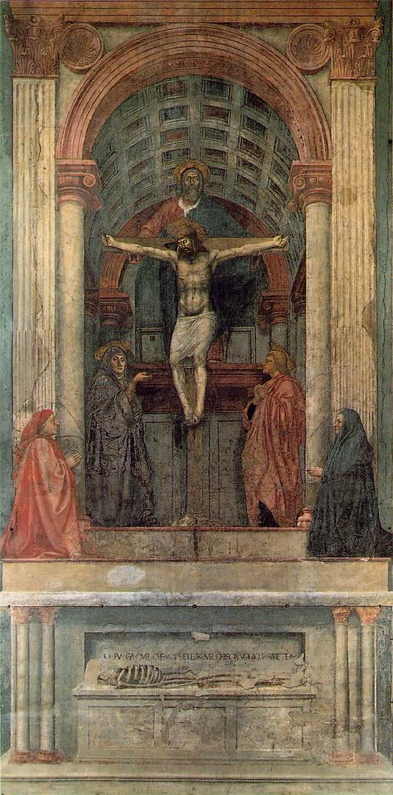
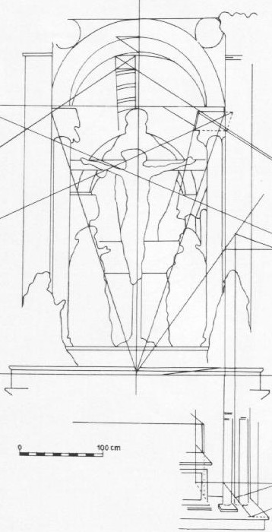
One-point perspective
Masaccio, Trinity, Santa Maria Novella, Florence, 1425-28
One of the first consistent uses of perspective in Western art

Slide 11
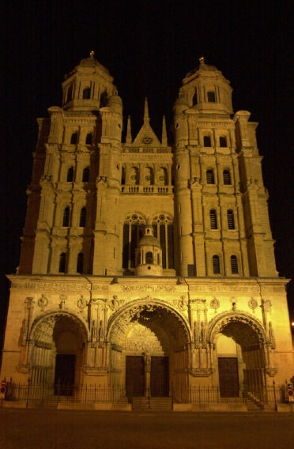
Perspective distortion
Problem for architectural photography: converging verticals
Source: F. Durand

Slide 12
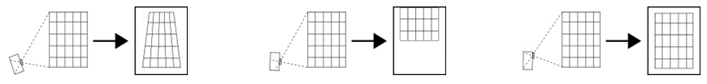
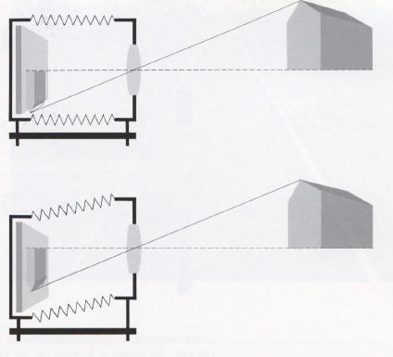
Perspective distortion
Problem for architectural photography: converging verticals
Solution: view camera (lens shifted w.r.t. film)
Tilting the camera upwards results in converging verticals
Keeping the camera level, with an ordinary lens, captures only the bottom portion of the building
Shifting the lens upwards results in a picture of the entire subject
http://en.wikipedia.org/wiki/Perspective_correction_lens
Source: F. Durand

Slide 13
Perspective distortion
Problem for architectural photography: converging verticals
Result:
Source: F. Durand

Slide 14
Perspective distortion
What does a sphere project to?
Image source: F. Durand

Slide 15
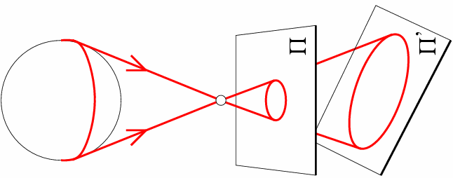
Perspective distortion
What does a sphere project to?

Slide 16
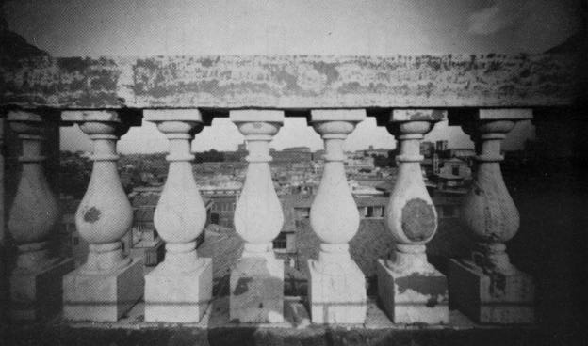
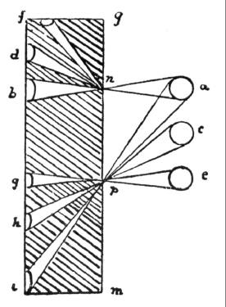
Perspective distortion
The exterior columns appear bigger
The distortion is not due to lens flaws
Problem pointed out by Da Vinci
Slide by F. Durand

Slide 17

Perspective distortion: People

Slide 18
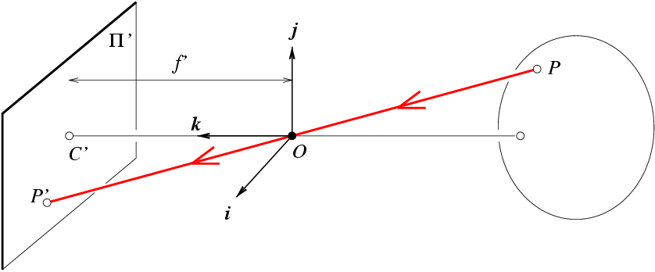
Modeling projection
y
f
z
x
The coordinate system
The optical center (O) is at the origin
The image plane is parallel to xy-plane (perpendicular to z axis)
Source: J. Ponce, S. Seitz
Notes:
This way the image is right-side-up

Slide 19
Modeling projection
y
f
z
x
Projection equations
Compute intersection with image plane of ray from P = (x,y,z) to O
Derived using similar triangles
We get the projection by throwing out the last coordinate:
Source: J. Ponce, S. Seitz
Notes:
The camera projection scales the apparent height of objects by the inverse of the depth. This results in the well-known effect that objects farther away from the camera look smaller.
We don’t care that the image is upside down: we can simply pretend that the image plane is in front of the camera center.

Slide 20
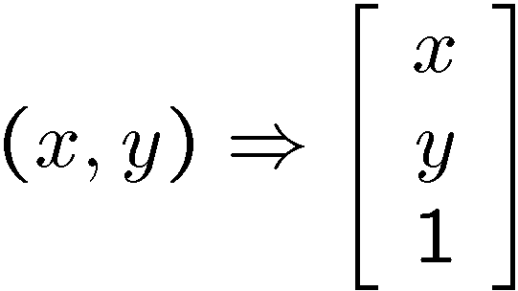
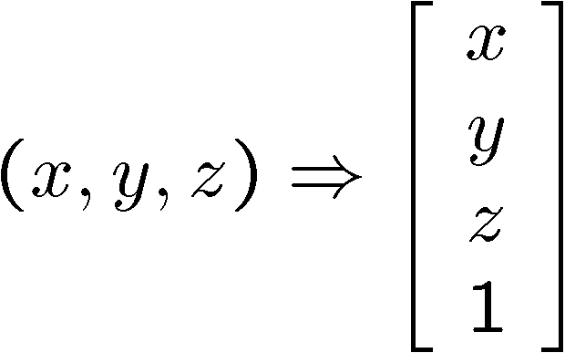
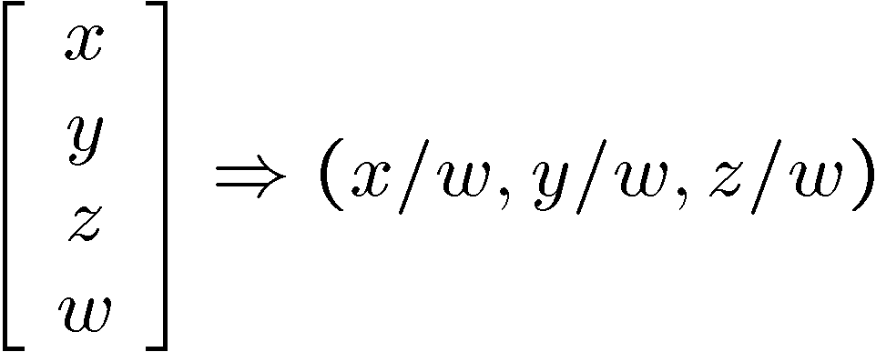
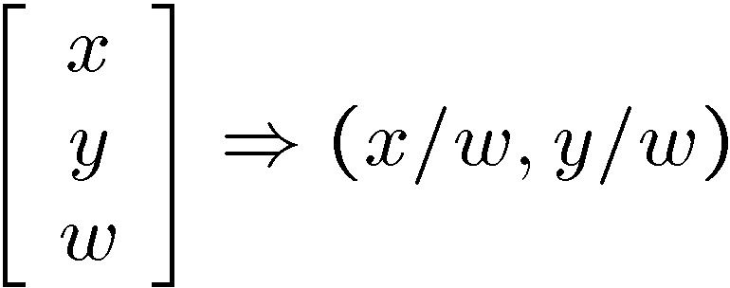
Homogeneous coordinates
Is this a linear transformation?
Trick: add one more coordinate:
no—division by z is nonlinear
homogeneous image
coordinates
homogeneous scene
coordinates
Converting from homogeneous coordinates
Slide by Steve Seitz

Slide 21
Perspective Projection Matrix
Projection is a matrix multiplication using homogeneous coordinates

Slide 22
Perspective Projection Matrix
Projection is a matrix multiplication using homogeneous coordinates
divide by the third coordinate

Slide 23
Perspective Projection Matrix
Projection is a matrix multiplication using homogeneous coordinates
divide by the third coordinate
In practice: lots of coordinate transformations…
World to camera coord. trans. matrix (4x4)
3D point (4x1)
2D
point (3x1)
Camera to pixel coord. trans. matrix (3x3)
Perspective projection matrix (3x4)
=

Slide 24
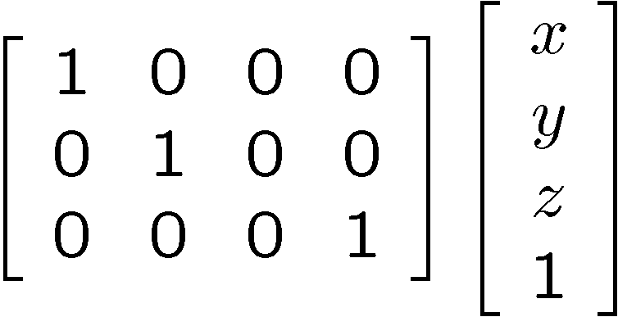
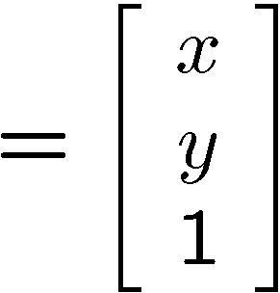

Orthographic Projection
Special case of perspective projection
Distance from center of projection to image plane is infinite
Also called “parallel projection”
What’s the projection matrix?
Image
World
Slide by Steve Seitz
Notes:
Is this a linear function?

Slide 25
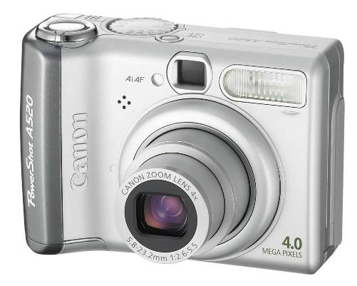
Building a real camera

Slide 26
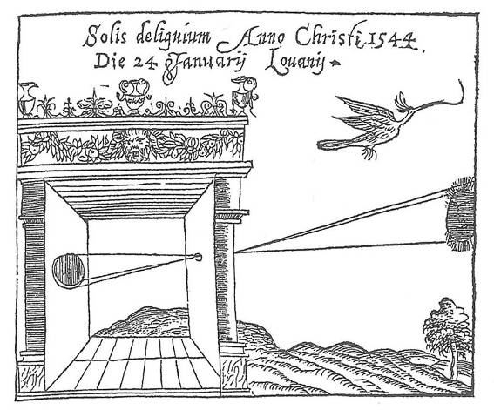
Camera Obscura
Basic principle known to Mozi (470-390 BCE), Aristotle (384-322 BCE)
Drawing aid for artists: described by Leonardo da Vinci (1452-1519)
Gemma Frisius, 1558
Source: A. Efros

Slide 27
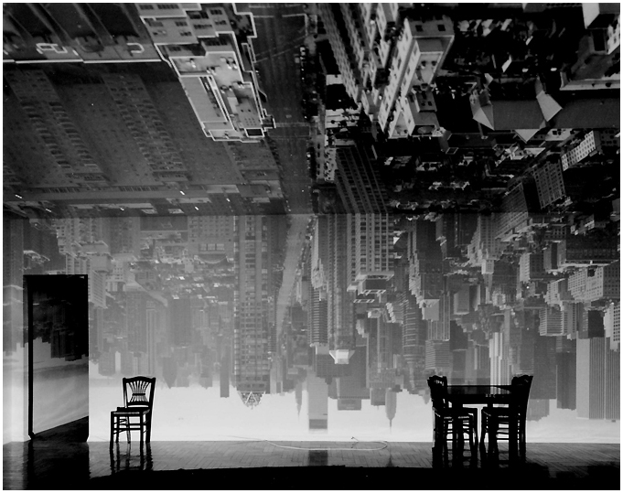
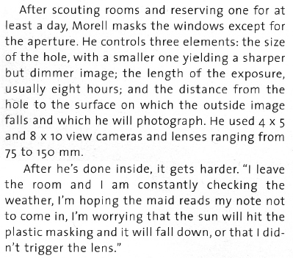
Abelardo Morell
From Grand Images Through a Tiny Opening, Photo District News, February 2005
Camera Obscura Image of Manhattan View Looking South in Large Room, 1996
http://www.abelardomorell.net/camera_obscura1.html

Slide 28
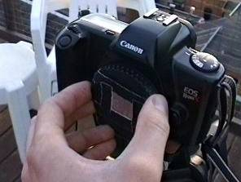
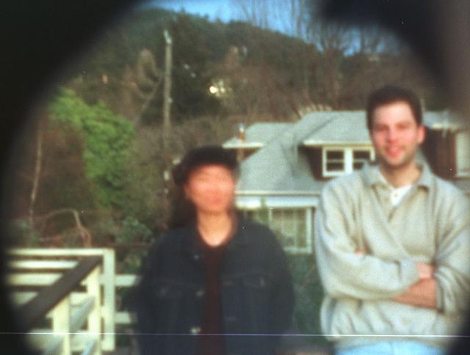
Home-made pinhole camera
Why so
blurry?
Slide by A. Efros
http://www.debevec.org/Pinhole/

Slide 29
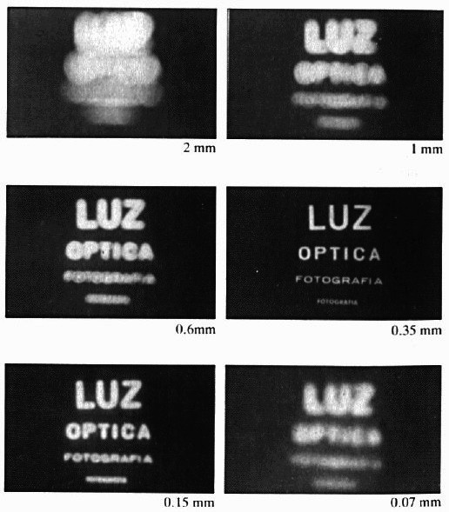
Shrinking the aperture
Why not make the aperture as small as possible?
Less light gets through
Diffraction effects…
Slide by Steve Seitz

Slide 30
Shrinking the aperture

Slide 31
Adding a lens
A lens focuses light onto the film
Thin lens model:
Rays passing through the center are not deviated (pinhole projection model still holds)
Slide by Steve Seitz

Slide 32
Adding a lens
focal point
f
A lens focuses light onto the film
Thin lens model:
Rays passing through the center are not deviated (pinhole projection model still holds)
All parallel rays converge to one point on a plane located at the focal length f
Slide by Steve Seitz

Slide 33
Adding a lens
“circle of
confusion”
A lens focuses light onto the film
There is a specific distance at which objects are “in focus”
other points project to a “circle of confusion” in the image
Slide by Steve Seitz

Slide 34
Thin lens formula
What is the relation between the focal length (f), the distance of the object from the optical center (D), and the distance at which the object will be in focus (D’)?
D’
D
f
image plane
lens
object
Slide by Frédo Durand
Notes:
This is the relation between the focal length (f), the distance of the object from the camera (D), and the distance at which the object will be in focus (D’)

Slide 35
Thin lens formula
Similar triangles everywhere!
D’
D
f
image plane
lens
object
Slide by Frédo Durand

Slide 36
Thin lens formula
y’/y = D’/D
Similar triangles everywhere!
D’
D
f
y
y’
image plane
lens
object
Slide by Frédo Durand

Slide 37
Thin lens formula
y’/y = D’/D
Similar triangles everywhere!
y’/y = (D’-f)/f
D’
D
f
y
y’
image plane
lens
object
Slide by Frédo Durand

Slide 38
Thin lens formula
1
1
1
Any point satisfying the thin lens equation is in focus.
+
=
D’
D
f
D’
D
f
image plane
lens
object
Slide by Frédo Durand
Notes:
And the set of all such points forms a plane parallel to the image (plane of focus).

Slide 39
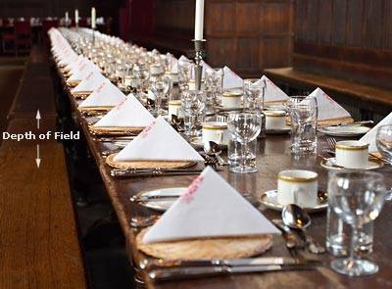
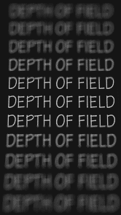
Depth of Field
http://www.cambridgeincolour.com/tutorials/depth-of-field.htm
Slide by A. Efros
Notes:
Depth of field is the range of distance within the subject that is acceptably sharp.

Slide 40
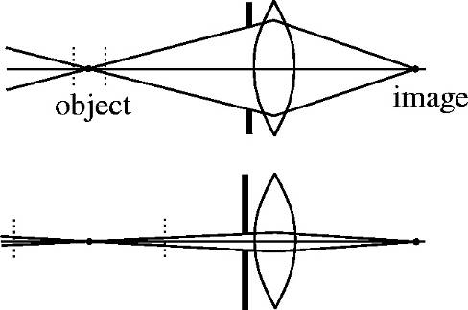
How can we control the depth of field?
Changing the aperture size affects depth of field
A smaller aperture increases the range in which the object is approximately in focus
But small aperture reduces amount of light – need to increase exposure
Slide by A. Efros

Slide 41
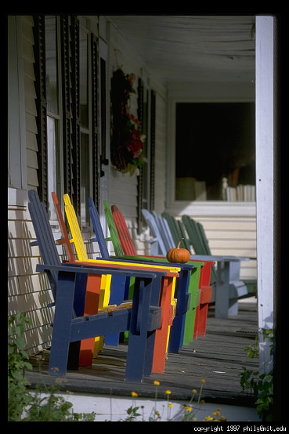
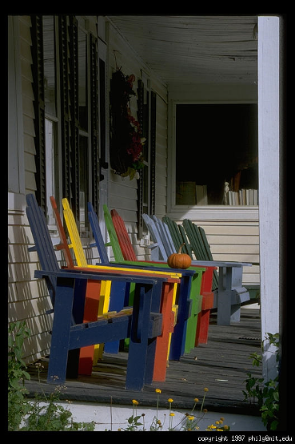
Varying the aperture
Large aperture = small DOF
Small aperture = large DOF
Slide by A. Efros

Slide 42
Field of View
Slide by A. Efros
Notes:
The field of view is the angular extent of the world that is observed by the camera.

Slide 43
Field of View
What does FOV depend on?
Slide by A. Efros

Slide 44
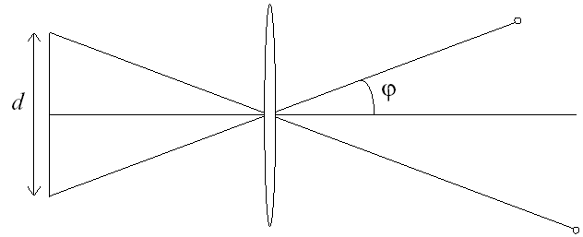
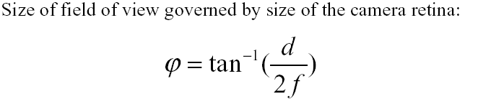
Field of View
f
f
FOV depends on focal length and size of the camera retina
Smaller FOV = larger Focal Length
Slide by A. Efros

Slide 45
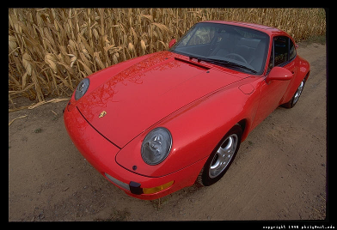
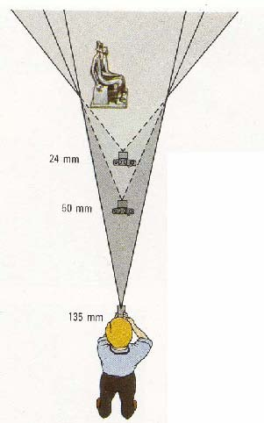

Field of View / Focal Length
Large FOV, small f
Camera close to car
Small FOV, large f
Camera far from the car
Sources: A. Efros, F. Durand

Slide 46



Same effect for faces
wide-angle
standard
telephoto
Source: F. Durand

Slide 47
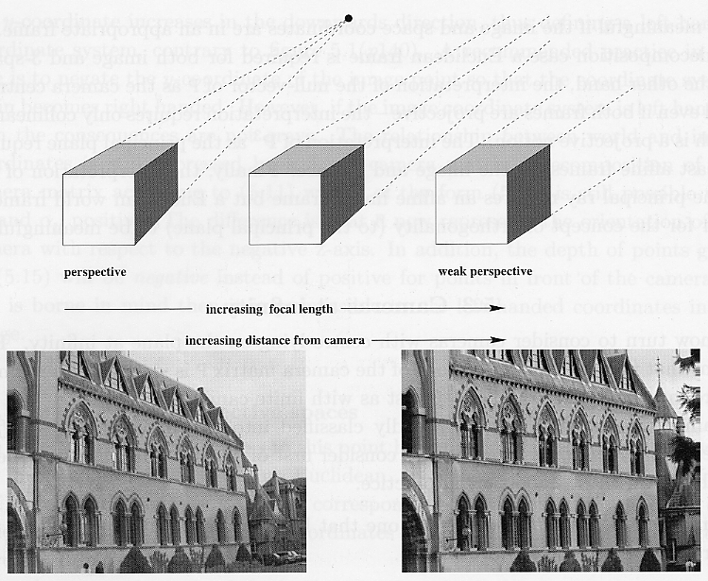
Approximating an affine camera
Source: Hartley & Zisserman

Slide 48
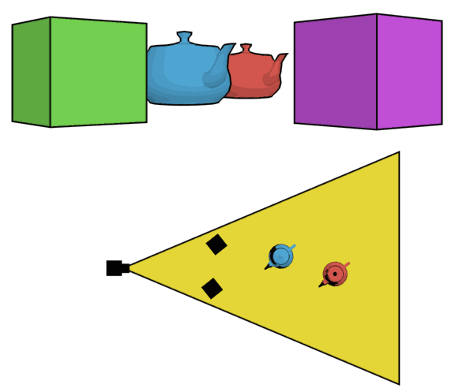
The dolly zoom
Continuously adjusting the focal length while the camera moves away from (or towards) the subject
http://en.wikipedia.org/wiki/Dolly_zoom

Slide 49
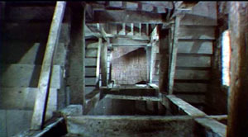
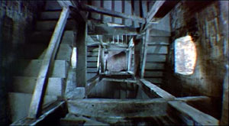
The dolly zoom
Continuously adjusting the focal length while the camera moves away from (or towards) the subject
“The Vertigo shot”
Examples of dolly zoom from movies (YouTube)

Slide 50
Real lenses

Slide 51
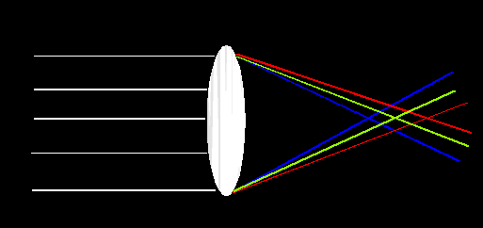
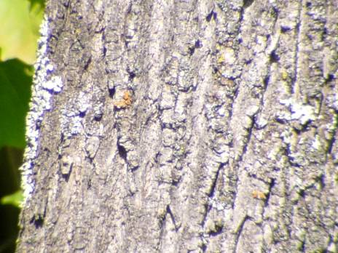
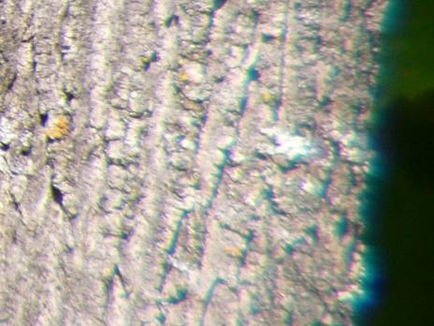
Lens Flaws: Chromatic Aberration
Lens has different refractive indices for different wavelengths: causes color fringing
Near Lens Center
Near Lens Outer Edge

Slide 52
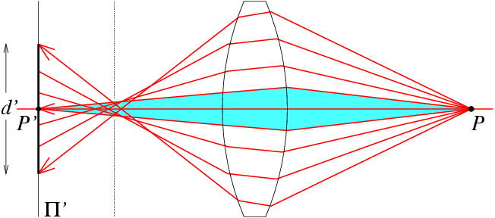
Lens flaws: Spherical aberration
Spherical lenses don’t focus light perfectly
Rays farther from the optical axis focus closer

Slide 53
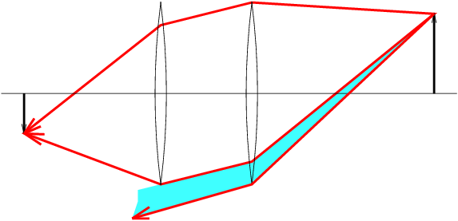
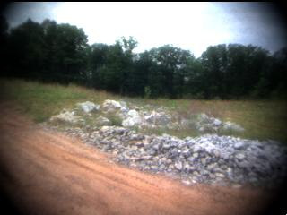
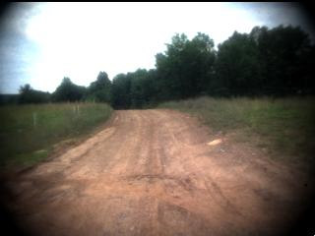
Lens flaws: Vignetting

Slide 54
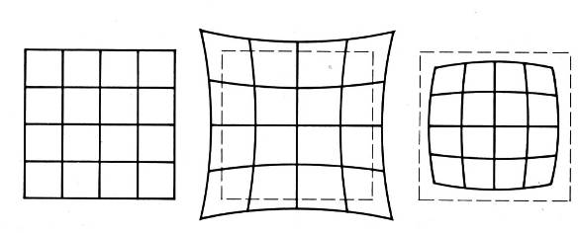
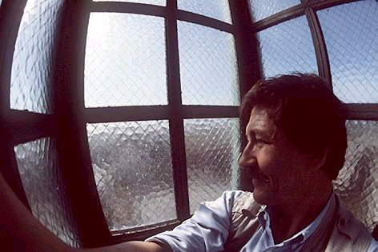
Radial Distortion
Caused by imperfect lenses
Deviations are most noticeable near the edge of the lens
No distortion
Pin cushion
Barrel

Slide 55
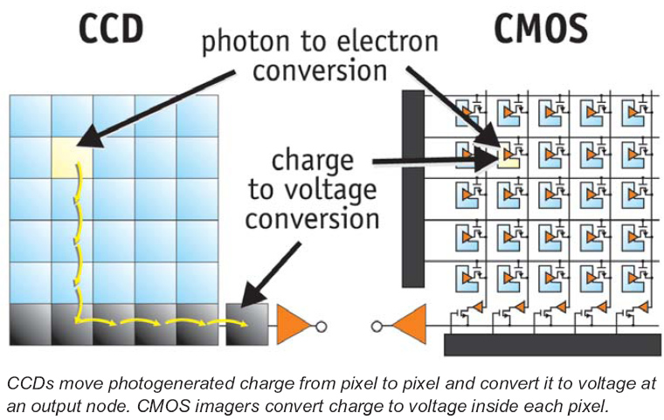
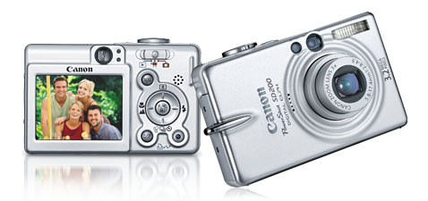
Digital camera
A digital camera replaces film with a sensor array
Each cell in the array is light-sensitive diode that converts photons to electrons
Two common types
Charge Coupled Device (CCD)
Complementary metal oxide semiconductor (CMOS)
http://electronics.howstuffworks.com/digital-camera.htm
Slide by Steve Seitz

Slide 56
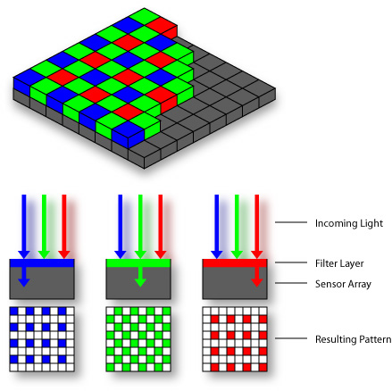


Color sensing in camera: Color filter array
Bayer grid
Estimate missing components from neighboring values (demosaicing)
Why more green?
Human Luminance Sensitivity Function
Source: Steve Seitz

Slide 57

Problem with demosaicing: color moire
Slide by F. Durand

Slide 58
The cause of color moire
detector
Fine black and white detail in image
misinterpreted as color information
Slide by F. Durand

Slide 59


Color sensing in camera: Prism
Requires three chips and precise alignment
More expensive
CCD(R)
CCD(G)
CCD(B)

Slide 60




Color sensing in camera: Foveon X3
CMOS sensor
Takes advantage of the fact that red, blue and green light penetrate silicon to different depths
http://www.foveon.com/article.php?a=67
http://en.wikipedia.org/wiki/Foveon_X3_sensor
better image quality
Source: M. Pollefeys

Slide 61



Digital camera artifacts
Noise
low light is where you most notice noise
light sensitivity (ISO) / noise tradeoff
stuck pixels
In-camera processing
oversharpening can produce halos
Compression
JPEG artifacts, blocking
Blooming
charge overflowing into neighboring pixels
Color artifacts
purple fringing from microlenses,
white balance
Slide by Steve Seitz

Slide 62



Historic milestones
Pinhole model: Mozi (470-390 BCE), Aristotle (384-322 BCE)
Principles of optics (including lenses): Alhacen (965-1039 CE)
Camera obscura: Leonardo da Vinci (1452-1519), Johann Zahn (1631-1707)
First photo: Joseph Nicephore Niepce (1822)
Daguerréotypes (1839)
Photographic film (Eastman, 1889)
Cinema (Lumière Brothers, 1895)
Color Photography (Lumière Brothers, 1908)
Television (Baird, Farnsworth, Zworykin, 1920s)
First consumer camera with CCD Sony Mavica (1981)
First fully digital camera: Kodak DCS100 (1990)
Alhacen’s notes
Niepce, “La Table Servie,” 1822
CCD chip

Slide 63




Early color photography
Sergey Prokudin-Gorskii (1863-1944)
Photographs of the Russian empire (1909-1916)
Assignment 1 (due February 1)!
Lantern
projector
http://en.wikipedia.org/wiki/Sergei_Mikhailovich_Prokudin-Gorskii
http://www.loc.gov/exhibits/empire/

Slide 64

First digitally scanned photograph
1957, 176x176 pixels
http://listverse.com/history/top-10-incredible-early-firsts-in-photography/

